Slide 1
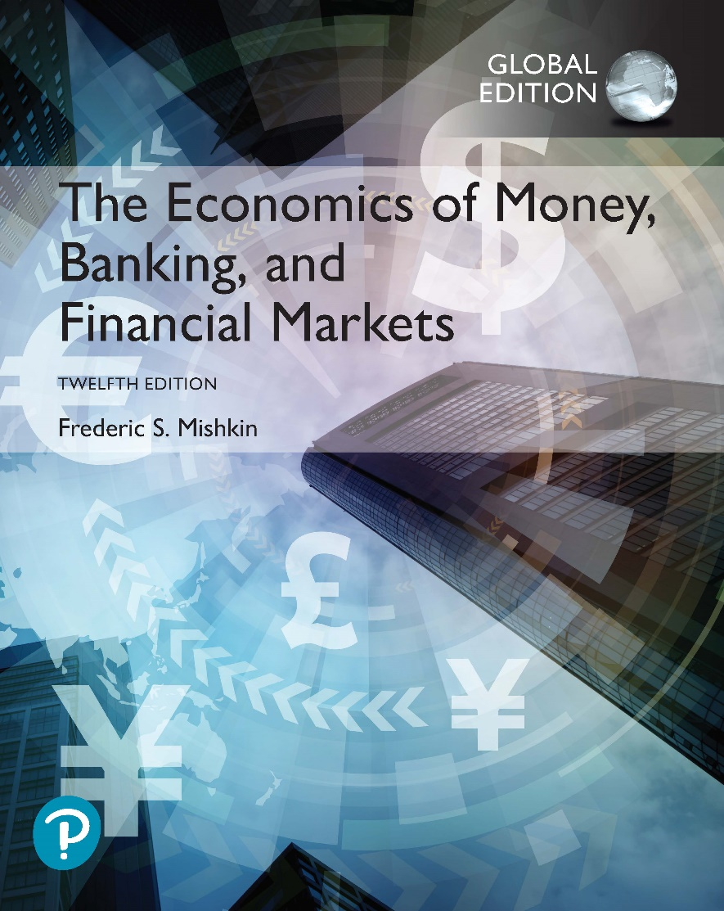
The Economics of Money, Banking, and Financial Markets
Twelfth Edition, Global Edition
Chapter 1
Why Study Money, Banking, and Financial Markets?
Copyright © 2019, 2016, 2013 Pearson Education, Inc. All Rights Reserved.
Notes:
If this PowerPoint presentation contains mathematical equations, you may need to check that your computer has the following installed:
1) MathType Plugin
2) Math Player (free versions available)
3) NVDA Reader (free versions available)

Slide 2
Preview
To examine how the workings of financial markets such as bond, stock and foreign exchange markets affect your everyday life
To examine how financial institutions such as banks, investment and insurance companies work
To examine the role of money in the economy

Slide 3
Learning Objectives (1 of 2)
Recognize the importance of financial markets in the economy.
Describe how financial intermediation and financial innovation affect banking and the economy.
Identify the basic links among monetary policy, the business cycle, and economic variables.

Slide 4
Learning Objectives (2 of 2)
Explain the importance of exchange rates in a global economy.
Explain how the study of money, banking, and financial markets may advance your career.

Slide 5
Why Study Financial Markets?
Financial markets are markets in which funds are transferred from people and firms who have an excess of available funds to people and firms who have a need of funds

Slide 6
The Bond Market and Interest Rates
A security (financial instrument) is a claim on the issuer’s future income or assets.
A bond is a debt security that promises to make payments periodically for a specified period of time.
An interest rate is the cost of borrowing or the price paid for the rental of funds.

Slide 7
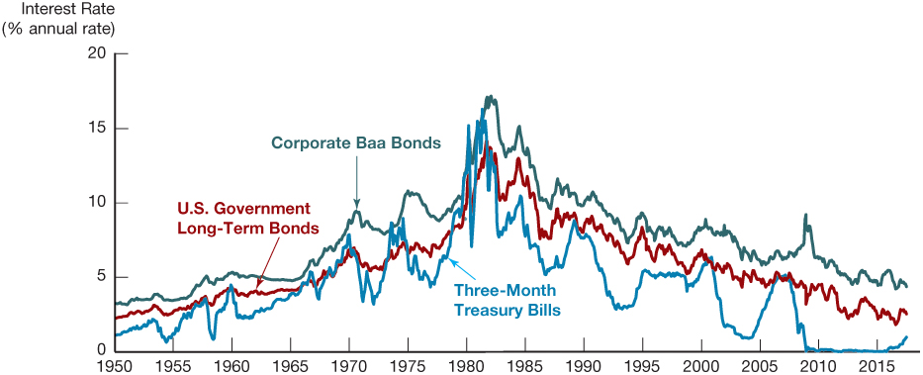
Figure 1 Interest Rates on Selected Bonds, 1950–2017
Source: Federal Reserve Bank of St. Louis, FRED database: https://fred.stlouisfed.org/series/TB3MS; https://fred.stlouisfed.org/series/GS10; https://fred.stlouisfed.org/series/BAA

Slide 8
The Stock Market
Common stock represents a share of ownership in a corporation.
A share of stock is a claim on the residual earnings and assets of the corporation.

Slide 9
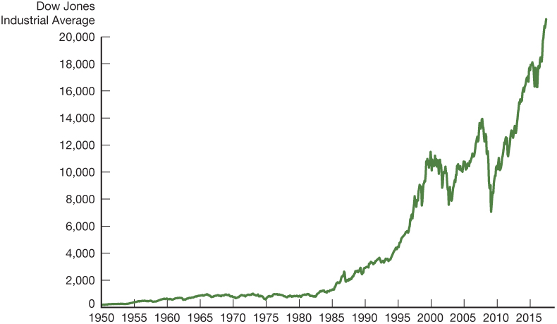
Figure 2 Stock Prices as Measured by the Dow Jones Industrial Average, 1950–2017
Source: Federal Reserve Bank of St. Louis, FRED database: https://fred.stlouisfed.org/series/DJIA

Slide 10
Why Study Financial Institutions and Banking? (1 of 3)
Financial intermediaries: institutions that borrow funds from people who have saved and in turn make loans to people who need funds.
Banks: accept deposits and make loans
Other financial institutions: insurance companies, finance companies, pension funds, mutual funds and investment companies
Financial innovation: the development of new financial products and services
e.g., the improvement of information technology leads to the ability to deliver financial services electronically (e-finance)

Slide 11
Why Study Financial Institutions and Banking? (2 of 3)
Financial innovation: the development of new financial products and services
Can be an important force for good by making the financial system more efficient
E-finance: the ability to deliver financial services electronically

Slide 12
Why Study Financial Institutions and Banking? (3 of 3)
Financial crises: major disruptions in financial markets that are characterized by sharp declines in asset prices and the failures of many financial and nonfinancial firms.

Slide 13
Why Study Money and Monetary Policy?
Evidence suggests that money, defined as anything that is generally accepted as payment for goods or services or in the repayment of debts, plays an important role in generating business cycles.
Recessions (unemployment) and expansions affect all of us.
Monetary theory ties changes in the money supply to changes in aggregate economic activity and the price level.

Slide 14
Money, Business Cycles, and Inflation
The aggregate price level is the average price of goods and services in an economy
A continual rise in the price level (inflation) affects all economic players
Data show a connection between the money supply and the price level

Slide 15
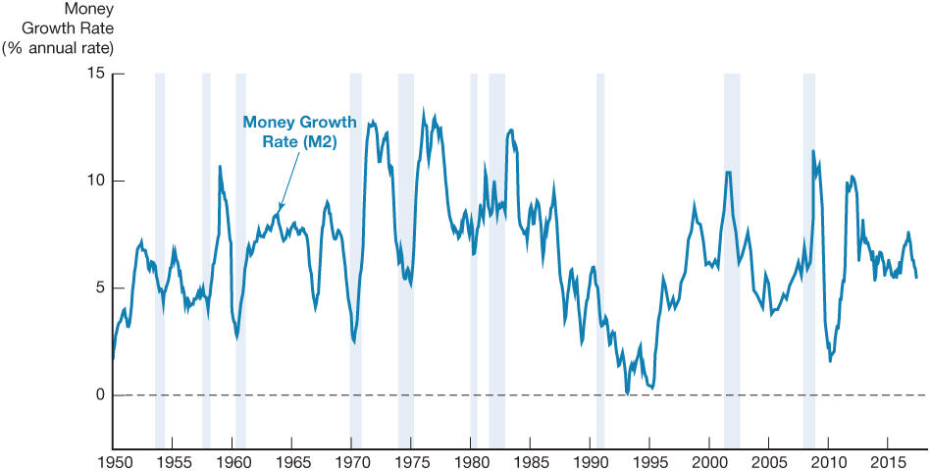
Figure 3 Money Growth (M2 Annual Rate) and the Business Cycle in the United States, 1950–2017
Source: Federal Reserve Bank of St. Louis, FRED database: https://fred.stlouisfed.org/series/M2SL

Slide 16
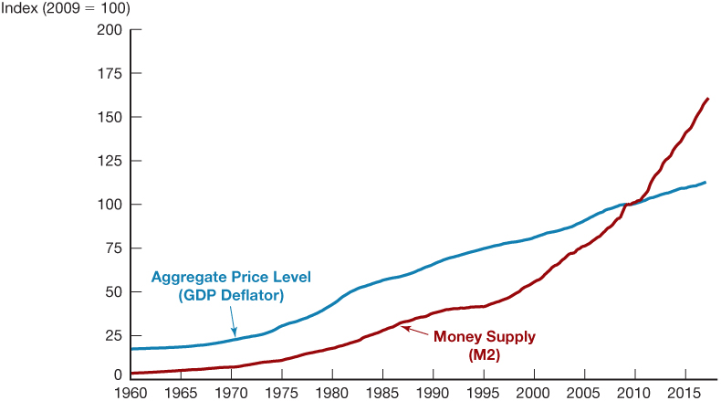
Figure 4 Aggregate Price Level and the Money Supply in the United States, 1960–2017
Source: Federal Reserve Bank of St. Louis, FRED database: https://fred.stlouisfed.org/series/M2SL; https://fred.stlouisfed.org/series/GDPDEF

Slide 17
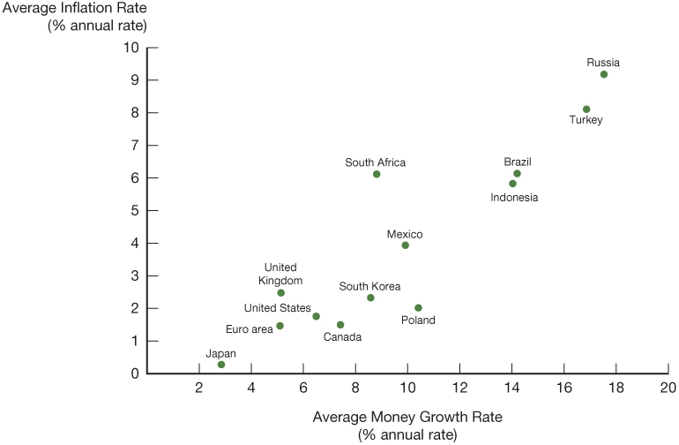
Figure 5 Average Inflation Rate Versus Average Rate of Money Growth for Selected Countries, 2006–2016
Source: Federal Reserve Bank of St. Louis, FRED database: https://fred.stlouisfed.org/

Slide 18
Money and Interest Rates
Interest rates are the price of money
Prior to 1980, the rate of money growth and the interest rate on long-term Treasury bonds were closely tied
Since then, the relationship is less clear, but the rate of money growth is still an important determinant of interest rates

Slide 19
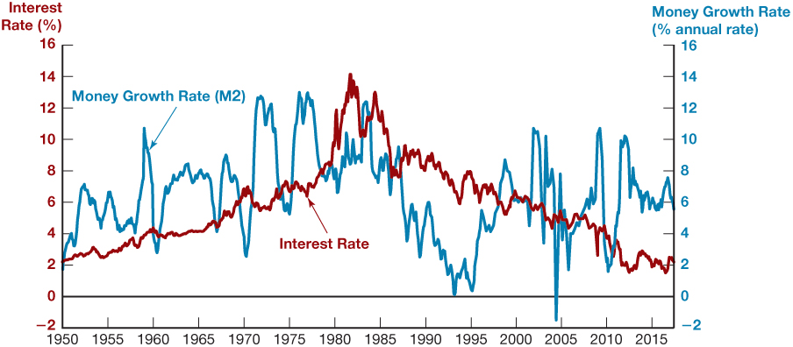
Figure 6 Money Growth (M2 Annual Rate) and Interest Rates (Long-Term U.S. Treasury Bonds), 1950–2017
Source: Federal Reserve Bank of St. Louis, FRED database: https://fred.stlouisfed.org/series/M2SL; https://fred.stlouisfed.org/series/GS10; https://fred.stlouisfed.org/series/M2SL

Slide 20
Fiscal Policy and Monetary Policy
Monetary policy is the management of the money supply and interest rates
Conducted in the United States by the Federal Reserve System (Fed)
Fiscal policy deals with government spending and taxation
Budget deficit is the excess of expenditures over revenues for a particular year
Budget surplus is the excess of revenues over expenditures for a particular year
Any deficit must be financed by borrowing

Slide 21
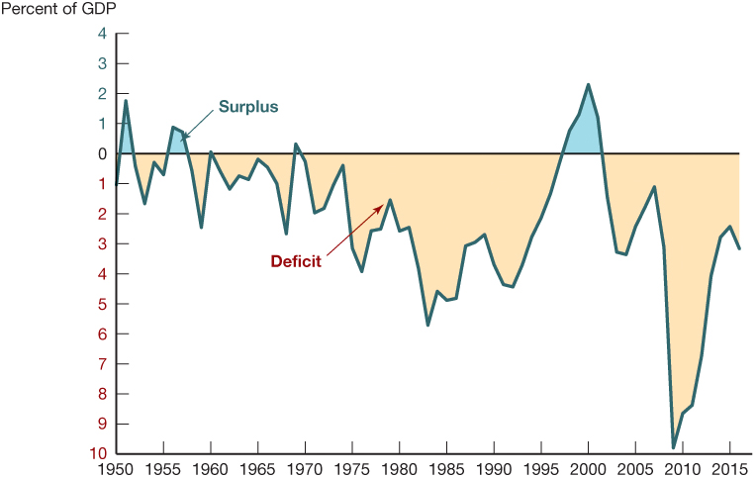
Figure 7 Government Budget Surplus or Deficit as a Percentage of Gross Domestic Product, 1950–2016
Source: Federal Reserve Bank of St. Louis, FRED database: https://fred.stlouisfed.org/series/M2SL; https://fred.stlouisfed.org/series/FYFSGDA188Sl

Slide 22
The Foreign Exchange Market
The foreign exchange market: where funds are converted from one currency into another
The foreign exchange rate is the price of one currency in terms of another currency.
The foreign exchange market determines the foreign exchange rate.

Slide 23
Why Study International Finance
Financial markets have become increasingly integrated throughout the world.
The international financial system has tremendous impact on domestic economies:
How a country’s choice of exchange rate policy affect its monetary policy?
How capital controls impact domestic financial systems and therefore the performance of the economy?
Which should be the role of international financial institutions like the IMF?

Slide 24
Figure 8 Exchange Rate of the U.S. Dollar, 1973–2017
Source: Federal Reserve Bank of St. Louis, FRED database: https://fred.stlouisfed.org/series/TWEXMMTH

Slide 25
The International Financial System
Financial markets have become increasingly integrated throughout the world.
The international financial system has tremendous impact on domestic economies:
How a country’s choice of exchange rate policy affect its monetary policy?
How capital controls impact domestic financial systems and therefore the performance of the economy?
Which should be the role of international financial institutions like the IMF?

Slide 26
Money, Banking, and Financial Markets and Your Career
Understanding monetary policy may help you predict when interest rates will rise or fall, help you make decisions about whether it is better to borrow now or to wait until later, know how banks and other financial institutions are managed which may help you get a better deal when you need to borrow from them and may enable you to make better investment decisions, whether for yourself or for the company you work for

Slide 27
How We Will Study Money, Banking, and Financial Markets
A simplified approach to the demand for assets
The concept of equilibrium
Basic supply and demand to explain behavior in financial markets
The search for profits
An approach to financial structure based on transaction costs and asymmetric information
Aggregate supply and demand analysis

Slide 28
Exploring the Web (1 of 2)
The importance of the World Wide Web is emphasized in several ways:
First, you can view the most current data for a high percentage of the in-text data figures by using eText to access the Federal Reserve Bank of St. Louis’s FRED database.
Second, at the end of almost every chapter there are several real-time data analysis problems, which ask you to download the most recent data from the Federal Reserve Bank of St. Louis’s FRED database and then use these data to answer interesting questions.

Slide 29
Exploring the Web (2 of 2)
Third, there are additional Web exercises at the end of many chapters that prompt you to visit sites related to the chapter and use them to learn more about macroeconomic issues.

Slide 30
Appendix 1:
Defining Aggregate Output, Income, the Price Level, and the Inflation Rate

Slide 31
Aggregate Output and Income
The most commonly reported measure of aggregate output, the gross domestic product (GDP), is the market value of all final goods and services produced in a country during the course of a year.
Aggregate income, the total income of factors of production (land, labor, and capital) from producing goods and services in the economy during the course of the year, is equal to aggregate output.

Slide 32
Real Versus Nominal Magnitudes (1 of 2)
When the total value of final goods and services is calculated using current prices, the resulting GDP measure is referred to as nominal GDP. The word nominal indicates that values are measured using current prices.

Slide 33
Real Versus Nominal Magnitudes (2 of 2)
A more reliable measure of economic production expresses values in terms of prices for an arbitrary base year, currently 2005. GDP measured with constant prices is referred to as real GDP, the word real indicating that values are measured in terms of fixed prices.

Slide 34
Aggregate Price Level
The aggregate price level is a measure of average prices in the economy.
Three measures of the aggregate price level are commonly encountered in economic data:
The GDP deflator
The PCE deflator
The Consumer Price Index (CPI)

